Slide 1
IMI National Observer Assessor Seminar 2024
Version Control Slide
Presentation: IMI Examiner Seminar 2024
Version: 1.0
Date: 12/01/2024
Approved by: Richard Gladman – Chief Examiner
Version ​ | Date​ | Summary of Changes​
1.0​ | 12/01/2024​ | Initial content​
​ | ​ | ​
​ | ​ | ​
​ | ​ | ​
​ | ​ | ​
Notes:
Remind people that the session is for one hour
Session will not be recorded
Use Chat facility for questions, which will be dealt with at the end, time permitting.
Feel free to eat/drink…but put yourself on mute and turn off the camera.
Remind everyone to save questions for the end
Respect and politeness
The presentation will be available under the IMI NOA section on the IAMRS Dashboard once all seminars are complete

Slide 2
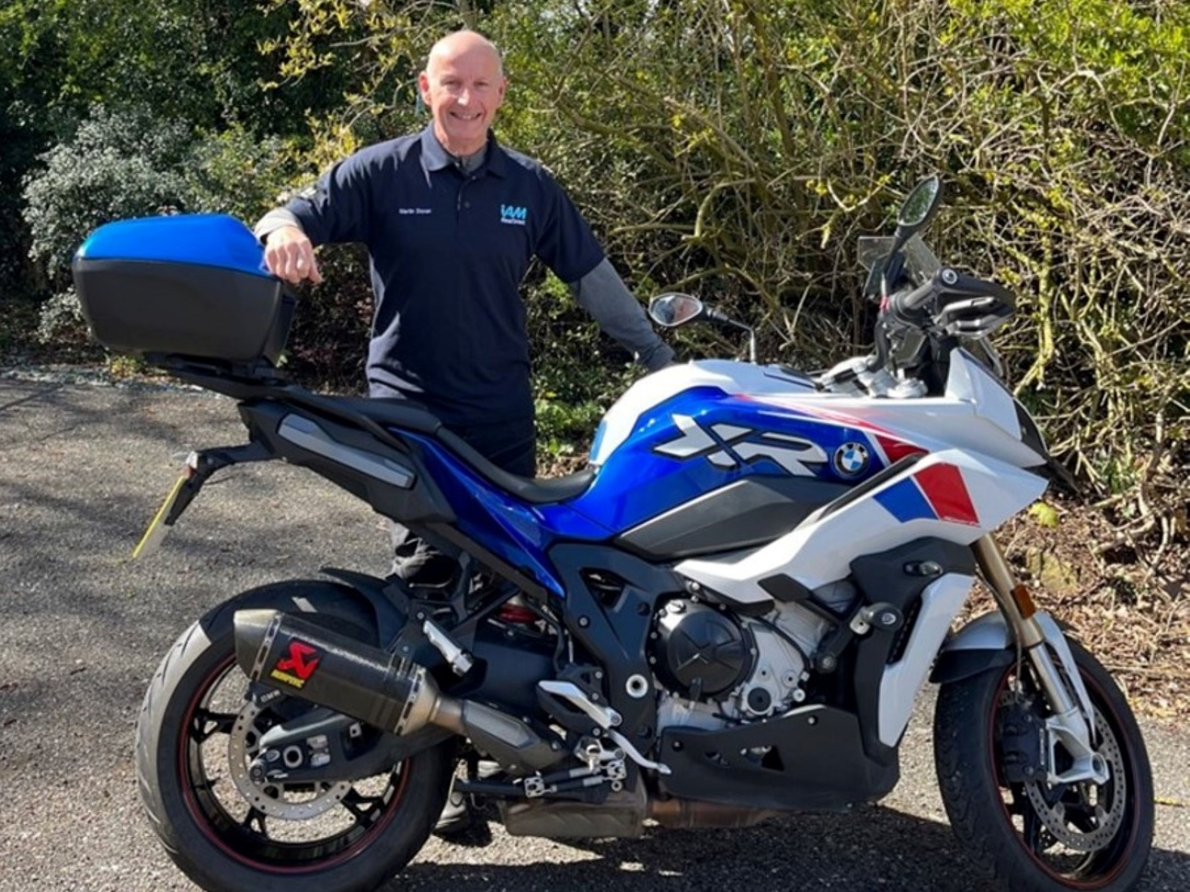
Examiner seminar March 2024

Slide 3
Introductions
Stuart Haythorn- Area Service Delivery Manager Region 2
Dave Cox- Area Service Delivery Manager Region 6

Slide 4
Privacy
No Recordings or Photos
Notes:
Gain agreement from the attendees that taking screen shots or recording the session is unacceptable.
“Can I get you all to give me a thumbs up to the camera to confirm that you all agree taking photos, screen shots or recordings of todays session is unacceptable and out of order.”

Slide 5
Notes:
Gain agreement from the attendees that taking screen shots or recording the session is unacceptable.
“Can I get you all to give me a thumbs up to the camera to confirm that you all agree taking photos, screen shots or recordings of todays session is unacceptable and out of order.”

Slide 6
Examiner Updates
Notes:
You will find our Zero Tolerance Statement on the IAM RoadSmart website. Please click on ‘About’ and then ‘Overview’ to find a copy.
Groups are now using this statement to challenge and manage abusive/aggressive behaviour.

Slide 7
IAM RoadSmart guidance document on the use of recording devices & Sat Nav’s
The IAM embraces the use of video recording devices for all forms of associate and observer training. In certain circumstances it may be required to have the device active during the test as a condition of insurance. An examiner will make every effort to accommodate this
The footage of the test must not be shared on social media and will not be used post-test to influence the result.
The decision of the examiner is final
Satellite navigation systems can remain switched on during the test, please do not insist they are switched off
If the associate has not been trained using radios please do not insist on using radios during the test

Slide 8
Complaints
We have updated our complaints procedures. Dashboard - Compliance and Policy
If a candidate raises a complaint to you - please pass to us to deal, do not get involved and do not take sides.
If they have problems with Group and/or members regarding values, attitudes behaviours, please tell us and we will deal with it.
You don’t have to deal with it!

Slide 9
The Examiners Dashboard & DARTS Portal
Notes:
You will find our Zero Tolerance Statement on the IAM RoadSmart website. Please click on ‘About’ and then ‘Overview’ to find a copy.
Groups are now using this statement to challenge and manage abusive/aggressive behaviour.

Slide 10
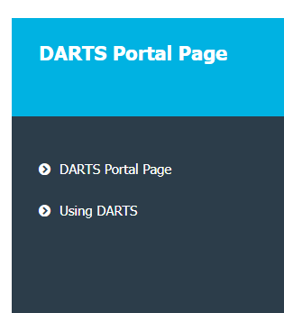
DARTS training videos – Your Dashboard

Slide 11
DARTS Diary & Requires Attention Field
On receipt of test notice and you are happy to take the test, accept it before trying to arrange date/time to carry out the test.
Remember to contact the associate within 5 working days. If contact cannot be made within 14 days, please advise Support using the Requires Attention field
If you need to reject the test – you must show the reason for rejection in the Requires Attention field.
Use the Requires Attention field for any issues and to claim extra mileage

Slide 12
DARTS Diary & Requires Attention Field
Darts Portal – My Assessments – select assessment – Alerts – click on box “Set Requires Attention”.
Provide details of your attempts to contact and reason for rejection.
Video showing use on Dashboard – Darts Portal Page – Using Darts

Slide 13
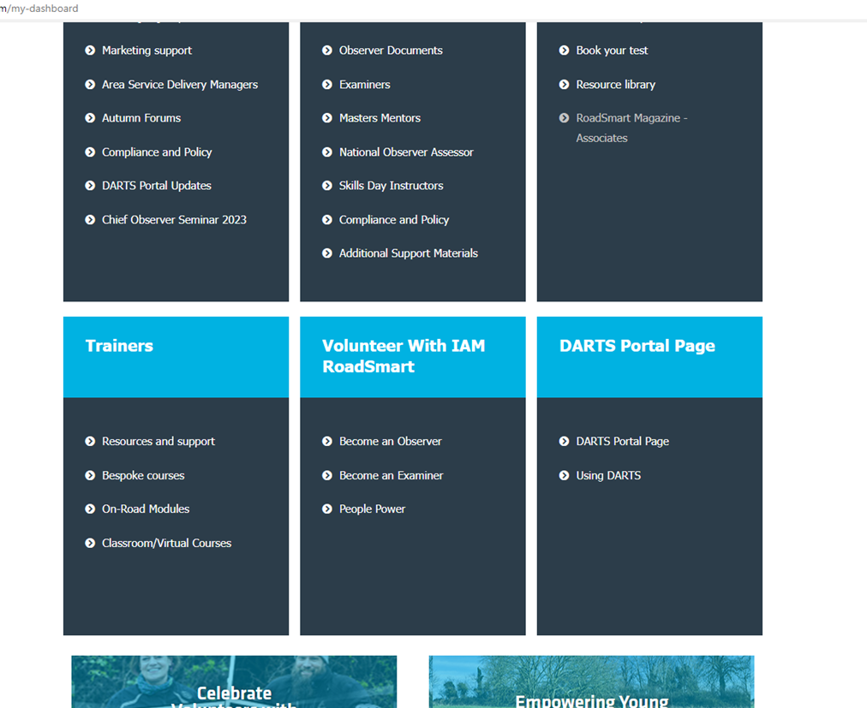
DARTS Diary & Requires Attention Field

Slide 14
Requires attention video

Slide 15
Diary
Don’t use the diary as a way of showing that you are unavailable/available to carry out tests as Support have no visibility of your diary (it’s meant for your use)
Send Support & ASDM an email showing leave etc. Please remember to email Support & ASDM on your return

Slide 16
Briefing & Debriefing
Notes:
You will find our Zero Tolerance Statement on the IAM RoadSmart website. Please click on ‘About’ and then ‘Overview’ to find a copy.
Groups are now using this statement to challenge and manage abusive/aggressive behaviour.

Slide 17
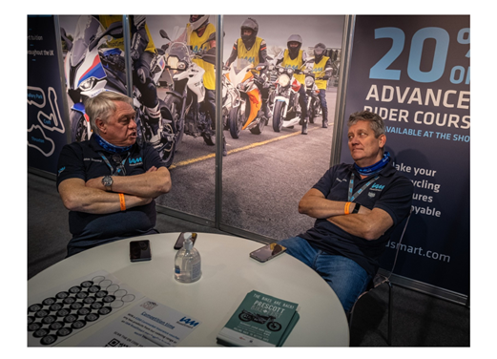
Basics of a Briefing or Debriefing
The test pass rate remains at just under 90% nationally and has been consistently around this level for several years.
Test nerves remain as the biggest barrier to success.
By all means introduce yourself and continue to be personable, but do not go into great depth about your background and driving qualifications – this is one of the biggest causes of complaint from a nervous associate as you are already revered as driving/riding “greats”, so the list of qualifications only adds to their nerves.

Slide 18
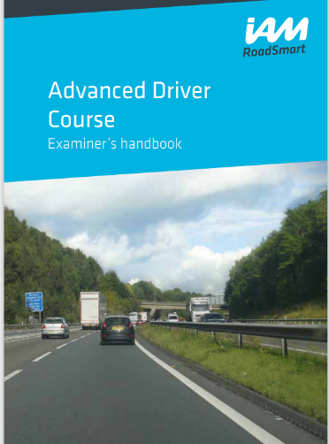
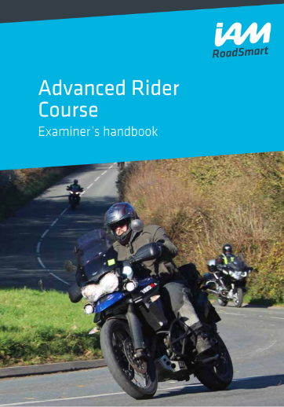
Basics of a Briefing or Debriefing
Be open and friendly but with a professional approach
Legality – eyesight test and document declaration
Deliver a concise briefing and structured debrief
Remember they are tested in what's in the ADC or ARC - they may not have Roadcraft.

Slide 19
Meeting venue (Safeguarding)
Meeting and finish venues – consider your own and associate’s safety – under 18s accompanied ( not required for bike tests)
Meet the associate during daylight hours in a safe public place, with access to facilities
Consider Welfare facilities
Consider Refreshment facilities
Be conversant with the generic IAM RoadSmart risk assessment for Examining (Examiner dashboard)
Please do not meet at your/their houses or laybys on dual carriageways

Slide 20
Tests and Assessments

Slide 21
Examiner National Pass Rate
This Photo by Unknown Author is licensed under CC BY-SA

Slide 22
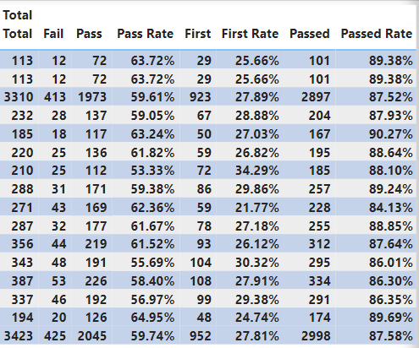
National Pass rate 88%

Slide 23
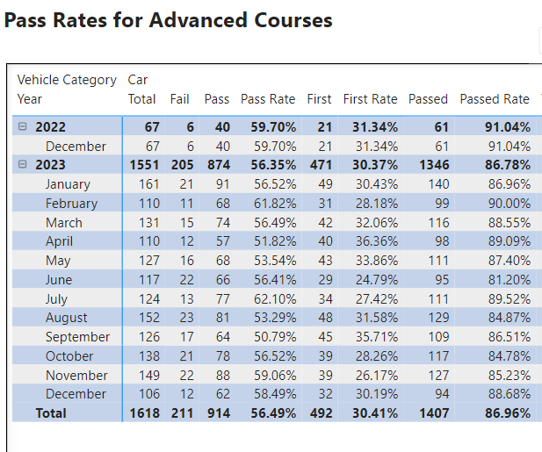
National Pass rate 87%

Slide 24
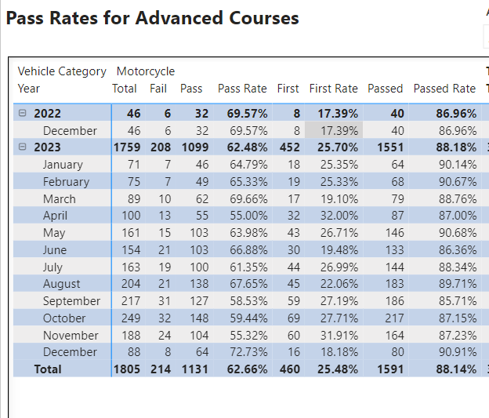
National Pass rate 88%

Slide 25
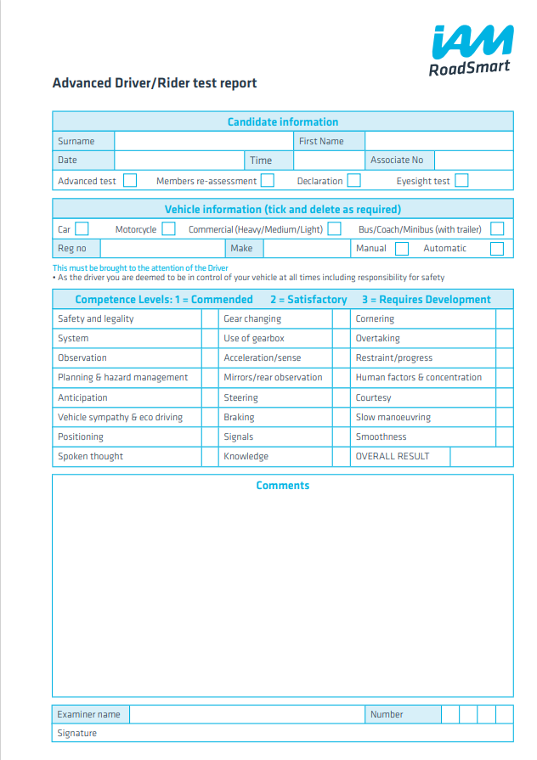
Scoring for Advanced Driver and Rider Tests
1 = Commend
Consistently demonstrates competency to a high standard with confidence; shows sound understanding of interaction between this and other competencies.
2 = Satisfactory
Consistently demonstrates competency
3 = Requires Development
Fails to consistently demonstrate competency

Slide 26
Awarding of a F1RST
No score of 3 in any section.
Examiners have the discretion to recommend a candidate even if they score a “2” in no more than three categories.
Those categories can be:-
Spoken Thoughts,
Vehicle Sympathy & Eco-Driving
Any one other category for Car or two other categories for Bike – except for Safety & Legality, and Slow Manoeuvring which must score a “1”
The remainder need to be scored 1

Slide 27
Tests
Fellows Test, Fellows Requalification, Members Assessment are all simply an Advanced Driver/Rider Test and need to be scored accordingly. Plus, you can also get a F1RST!
If your candidate is an Observer for the class of vehicle that they are taking a test in (Car Observer for car test – m/cycle Observer for m/cycle test) and they are unsuccessful, please inform your ASDM with result and copy of your report.

Slide 28
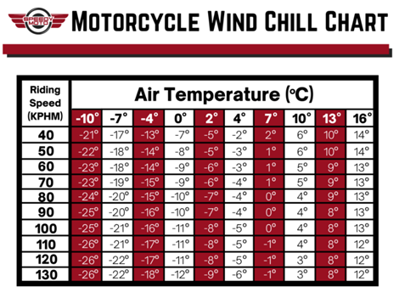
Tests
Below freezing overnight and doesn’t exceed +5 degrees – consider rescheduling ride/drive. As the Examiner, you make the decision.☺

Slide 29
EV’s and Automatics
Leaving an automatic vehicle in ‘Drive’ for the entire test does not constitute a score of 3. If the vehicle is in ‘Park’ when you enter it and ‘Drive’ is selected throughout the journey and ‘Reverse’ is selected for a slow speed manoeuvre, then this should attract a score of 2 – Satisfactory
If candidate can explain why leaving it alone (and is correct in their explanation) then consider a ‘1’ e.g. “positronic gear box doesn’t necessarily engage to higher gear on steep descent and therefore a lower gear doesn’t need to be engaged to control descent speed.”
“Flappy Paddle” use can be explained by candidate if not used. No need for them to use if not required.

Slide 30
EV’s and Automatics
DCT type gearboxes are going to become more common and depending on the variant may need to be placed in neutral whilst stationary at traffic lights etc
Quick shifters on bikes are not auto boxes
EV’s - Regenerative braking is part of the Speed loss phase. Leave time for the vehicle to settle before negotiating the hazard
Scoring for gears in EV. Score ‘1’ in older test booking so it does not affect the chance of gaining a F1RST and show reason in test report – e.g. BMW electric car without gears or driver changeable mode settings.
On new test booking, DARTS report will have drop down for gears will include N/A. (cars and bikes)

Slide 31
Admin & Reports
Remember to use evidenced reporting
Please proofread your reports, check spelling and grammar
Complete a meaningful written report in DARTS covering what went well and what can still be worked on in a short development plan
Provide reports with evidence to justify scores. “ Well done - a good advanced drive/ride.” - no longer cuts it ☺

Slide 32
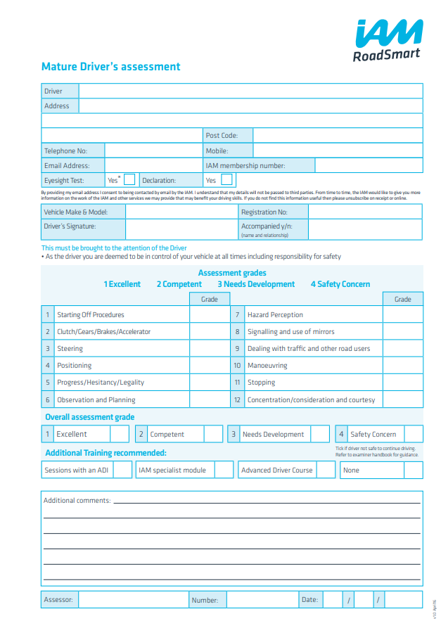
Mature Driver Review
Unbiased assessment not a test
Never give ‘instruction,’ ‘guidance’ or ‘teach’
Am I safe to drive?
Normal daily drive – keep in comfort zone
DVSA test standard – safe and competent drive

Slide 33
Volunteer Examiners and Expenses
Notes:
You will find our Zero Tolerance Statement on the IAM RoadSmart website. Please click on ‘About’ and then ‘Overview’ to find a copy.
Groups are now using this statement to challenge and manage abusive/aggressive behaviour.

Slide 34
Volunteers rights and expenses Source: GOV.UK
Pay and expenses
You are not paid for your time as a volunteer, but you may get money to cover expenses. This is usually limited to food, drink, travel or any equipment you need to buy
You may need to pay tax on your driving expenses if you get back more than you spent
IR 35: You might be classed as an employee or worker rather than a volunteer if you get any other payment, reward or benefit in kind which may affect your ‘IR35 status’
Travel – Mileage and fuel rates and allowances are set by HMRC - the mileage rate for 2023 remains at 45p per mile for the first 10,000 miles and 25p per mile after that for business-related driving. For motorcycles, the rate is 24p per mile.

Slide 35
Safeguarding Statement & Zero Tolerance Policy
Notes:
You will find our Zero Tolerance Statement on the IAM RoadSmart website. Please click on ‘About’ and then ‘Overview’ to find a copy.
Groups are now using this statement to challenge and manage abusive/aggressive behaviour.

Slide 36
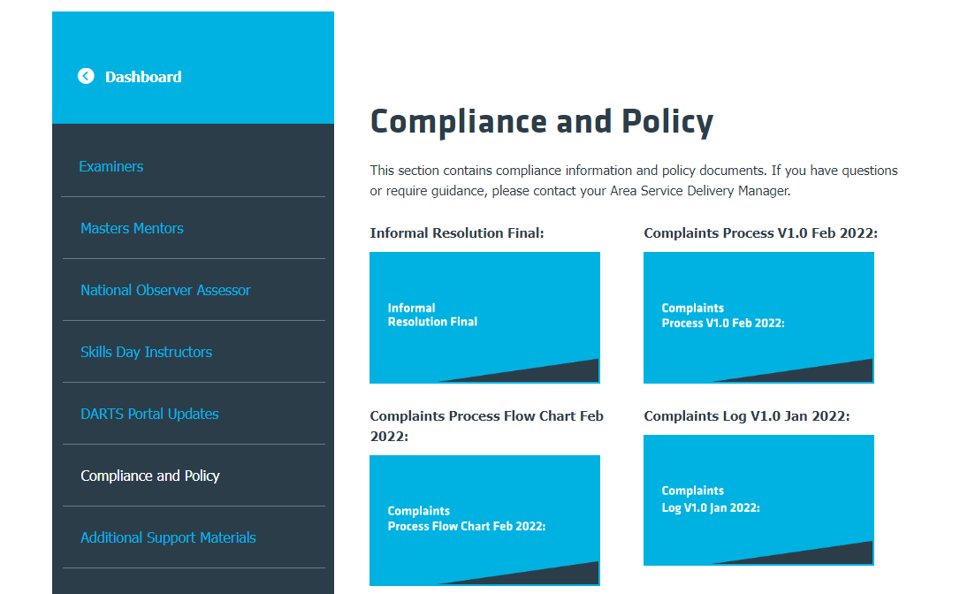
Safeguarding Statement & Zero Tolerance policy
IAM RoadSmart have a Safeguarding Policy which is an important document which all examiners must familiarise themselves with.
IAM RoadSmart will not tolerate threatening, abusive, or violent behaviour and the zero-tolerance policy puts measures in place to protect the volunteers and staff
Both items can be found on the Dashboard – under ‘Compliance and Policy’.
Notes:
IAM RoadSmart will not tolerate threatening, abusive, or violent behaviour
Under these circumstances our staff and volunteers should not be required to or feel obliged to deal with any person either face to face, over the phone or in email or written correspondence
When using the zero tolerance policy please remember you will always be required to:-
document the incident and your investigation
provide supporting evidence
ensure the result of your investigation and the outcome is clearly communicated by letter/email to your member
retain all documentation for a period of 6 years
We would like to highlight that although this statement supports a ‘one strike and you’re out’ approach there may be times when the only option is to terminate membership immediately. If you reach this decision you will still need to comply with all the points above.
Please contact your ASDM for advice at the earliest opportunity – swift, yet considered action is required.

Slide 37
General Data Protection Regulation (GDPR) came into effect in the UK on 25 May 2018

Slide 38
General Data Protection Regulations
In order to comply with GDPR IAM RoadSmart as ‘Controllers’ provide Examiners as ‘Processors’ with personal data on associates and members:-
Name
Address
Gender
Year of birth (if they have provided it)
Post code
Email address
Contact phone numbers

Slide 39
General Data Protection Regulations
You must not record, collect, use or retain any other personal data
For example:-
Driving licence number
Driving conviction information (yes, this has been asked for at test)
Vehicle registration number – except to identify candidate at meeting venue
Number of years driving or riding etc

Slide 40
General Data Protection Regulations
Personal data must be stored securely - if electronically stored it must be password protected with a strong password
Only keep personal data for as long as you have a legitimate reason for holding it
You must securely destroy all personal data relating to delegates once you have submitted your DARTS report
If you later need details e.g. Tax returns then retrieve it from your DARTS record
Remember to destroy all hard copies of notifications and test reports
Remember to delete contact numbers from your phone

Slide 41
Questions

Slide 42
Thank you

