Slide 1
IMI National Observer Assessor Seminar 2024

Slide 2
IMI National Observer Assessor Seminar 2024
Version Control Slide
Presentation: IMI National Observer Assessor Seminar 2024
Version: 1.0
Date: 12/01/2024
Approved by: Richard Gladman – Chief Examiner
Version ​ | Date​ | Summary of Changes​
1.0​ | 12/01/2024​ | Initial content​
​ | ​ | ​
​ | ​ | ​
​ | ​ | ​
​ | ​ | ​
Notes:
Remind people that the session is for one hour
Session will not be recorded
Use Chat facility for questions, which will be dealt with at the end, time permitting.
Feel free to eat/drink…but put yourself on mute and turn off the camera.
Remind everyone to save questions for the end
Respect and politeness
The presentation will be available under the IMI NOA section on the IAMRS Dashboard once all seminars are complete

Slide 3
IMI National Observer Assessor Seminar 2024
Introduction
Steve Ellis, Area Service Delivery Manager Region 5
Scott Tulip, Area Service Delivery Manager Region 7
Notes:
Any additional Staff present

Slide 4
IMI National Observer Assessor Seminar 2024
Website Dashboard
Resources
Candidate Awareness
Notes:
CLICK
This has been heavily revised and re-organised; you need to be familiar with it.
There is a section here for IMI National Observers.
CLICK
Is the candidate aware of it?

Slide 5
Notes:
The Dashboard. Depending on your role yours may look slightly different.
On the bottom right you will see the DARTS tab.
One of these options is the ‘DARTS Portal Page’ which is where you can report a problem or view release notes on new versions.
‘Using DARTS’ is the other option. Clicking that…

Slide 6
Notes:
…brings you here.
There are various short videos here that show you how to do various tasks in DARTS.
They won’t all be relevant to you, but some will be useful.

Slide 7
Notes:
Let's go back to your Dashboard and check out the 'Volunteer Resources' tab.
There are sections for IMI National Observers and Observer Documents, and here you will find the editable Document Declaration.

Slide 8
Notes:
Brief Description of the ‘Assessment Guidance Documents’
All IMI National Observer Assessors must follow the Guidance Notes (including timings). We must have a consistent approach.

Slide 9
Notes:
Talk about the Assessment Examples. If you need more assistance, contact ASDM.
At the bottom are the NOPS forms. Although not used by IMI National Observer Assessors, they are a useful aide-memoire to send to candidates as well as yourself.

Slide 10
Notes:
Scrolling further we come to the final selection, ‘Other Supporting Documents’
These are very useful and rather than waiting until you have a problem before referring to them, take a look now; give yourself a working knowledge so hopefully you can avoid a situation developing.
We can all usually tell from a situation if a complaint is likely to be forthcoming. If you think that is likely, please speak to your ASDM asap
If you feel there is something that could be added to the IMI National Observer Assessor section, or Volunteer Resources at all, then please enter it in the chat now, or contact your ASDM
.

Slide 11
IMI National Observer Assessor Seminar 2024
Communications
Notifications from IMI
Contact within 5 days would be appreciated
Update DARTS
Complete DARTS report, again within 5 days of assessment please
Notes:
CLICK Without a notification from IMI Qualifications, the assessment cannot take place. You will be notified at the same time as the candidate. If you think there may be a conflict of interests, (Personal friends, past disagreements etc.) contact your ASDM immediately.
CLICK Upon receipt of the email notification, contact the candidate, introduce yourself as their assessor and ask about suitable dates and times for the assessment. We would appreciate if you could do this within 5 days. The candidates have worked hard for this, and we want to be fair to them and match their expectations.
CLICK Note the progress of the assessment on DARTS (Accepted, Appointment set etc).
If you reject the appointment, you MUST enter a reason when prompted, and un-set the appointment
CLICK Again, we would appreciate this being completed within 5 days so we can get the information out to the candidate.
If you reject the appointment, you MUST enter a reason when prompted.

Slide 12
IMI National Observer Assessor Seminar 2024
Communications
E-mail clarity and consistency
Confirmation email including…
Necessary attachments
Assess response style from candidate
Notes:
CLICK Consider using a template for your emails. These need to be consistent and clear. All candidates must receive the same basic information.
CLICK After you have agreed on a date and time, confirm in an email with your chosen scenario.
CLICK Attach relevant documents to that email, such as the Candidate Guidance, a NOPS form and Document Declarations – one completed by you, the other blank for them to return.
CLICK It is also worth noting the communications you get back regarding the manner and time to respond; are the language and style suitable for contact with a new associate? Where they prompt, or delayed?

Slide 13
IMI National Observer Assessor Seminar 2024
Communications
Assess reply from candidate
Personal Standards (yours and theirs)
Risk Assessment
Notes:
CLICK Their reply should also give you a meeting venue. Does this comply with IAM RoadSmart guidelines?
CLICK Smart suitable clothing for both you and the candidate, IAM RoadSmart branded clothing wherever possible. Are both vehicles clean and presentable, taking into account prevailing weather conditions? Are car interiors clean and litter-free?
CLICK The generic IAM RoadSmart risk assessment for Observing is the appropriate one for you to use in your role.

Slide 14
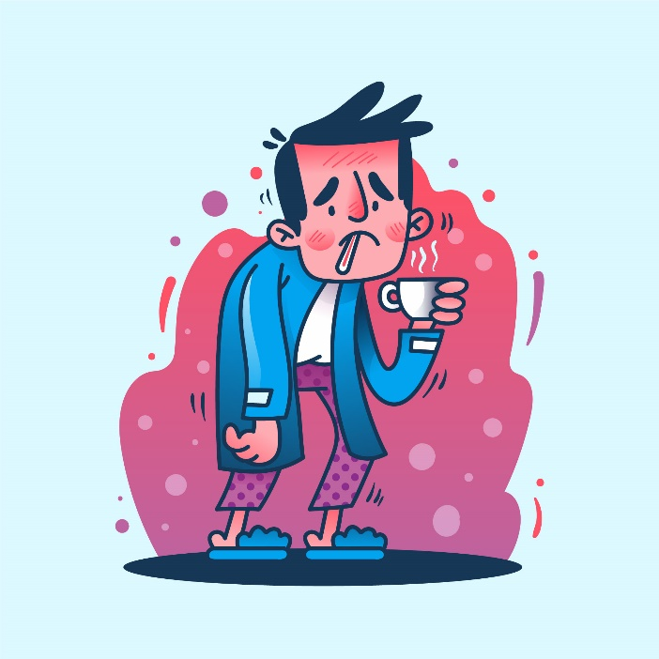
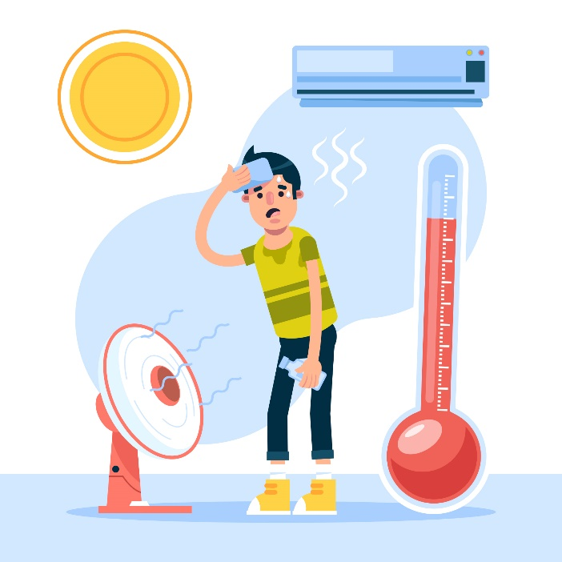
IMI National Observer Assessor Seminar 2024
Cancellations
Sickness
Mechanical Problems
Weather Extremes
Candidates will often thank you for this!
Images by pikisuperstar on Freepik.com
Notes:
CLICK Sickness can happen at any time, to anybody, so this could be you or the candidate
CLICK Mechanical problems can, again, occur to anyone. Have the candidate’s mobile number as a hard copy or stored on your phone. Don’t rely on cloud services, but remember to delete afterwards (GDPR)
CLICK Most of you know about the ‘5 degree’ guidance; Below freezing overnight and doesn’t exceed +5 degrees in the day – consider rescheduling ride/drive. As the Assessor, you make the decision. Be sensible and don’t forget heat extremes can be just as dangerous.
CLICK They will often breathe a sigh of relief as they consider cancelling, but don’t want to appear weak. They want someone else to take the decision for them.

Slide 15
IMI National Observer Assessor Seminar 2024
Assessment Timings
New IMI NO
Meet and greet
5 minutes
NO brief to Associate
10-20 minutes
Observed ride/drive by NO of Associate (NOA)
To include mid-ride stop with short de-brief. (MC only as car is continuous coaching with appropriate improvements)
30-40 minutes
De-brief of Associate by NO
10-20 minutes
Assessor brief to NO
5-10 minutes
Assessed drive/ride
May include parking/slow manoeuvring
30-40 minutes
Theory and protocol questions
5-10 minutes
Result and Assessor de-brief to NO
15-20 minutes
Notes:
New NO about 2 hours.
Motorcycle assessments may take slightly longer due to the removal of clothing and re-dressing.
This does not account for time spent over a coffee, etc
A referral (re-test) will be allocated the same time as the normal assessment but please note it may only be for either their riding/driving skills or their observing skills, resulting in the assessment time being halved.

Slide 16
IMI National Observer Assessor Seminar 2024
Assessment Timings
IMI NO QA
NO brief to Associate
5 minutes
Observed ride/drive by NO of Associate
15 - 20minutes
De-brief of Associate by NO
5 minutes
Assessed ride/drive
May include parking/slow manoeuvring
25 - 30 minutes
Assessor de-brief to NO
15 - 20 minutes
Notes:
IMI NO QA (re-qualification) is about an hour
Motorcycle assessments may take slightly longer due to the removal of clothing and re-dressing.
Again, his does not account for time spent over a coffee, etc

Slide 17
IMI National Observer Assessor Seminar 2024
Role Play Guidance
Safe and Legal
Encourage Success
Stick with the plan
Notes:
CLICK It MUST be safe and legal at all times without exception. Do not place yourself in danger by, for example, overtaking between vehicles, exceeding speed limits, contravening STOP signs etc.
CLICK The idea is not to catch the observer out, which is easy to do, but to assess their skill and competency, NOT their experience; that will come with time. This is a pass/fail assessment, there is no F1RST equivalent. They have to be ‘good enough’
CLICK You must have decided on your role BEFORE the ride/drive commences, so have a plan and stick with it. Know what faults you are going to display, and their cause.
Changing your plan mid-session is unfair on your candidate and you will also confuse yourself.

Slide 18
IMI National Observer Assessor Seminar 2024
Role Play Guidance
A competent briefing
Adapt where necessary
Be flexible in your plan
Notes:
CLICK Do not lose sight of the fact that the candidate could deliver a comprehensive briefing with development points covering the scenario before you set off. If they ask you the right questions and listen to your answers this could, and does, happen. Reward that.
CLICK If the briefing is so good that it ‘corrects’ your planned faults, it would be perverse to ride to your intended plan.
CLICK You could still display some minor points to improve on or ride/drive well. If the mid-ride brief reflects that good ride, then the second part should be good, too.
This decision, and the reasons behind it, should be evidenced in your report.

Slide 19
IMI National Observer Assessor Seminar 2024
Reports Standards
Evidence based
Development Plan
A ‘Pass’ must say so
Verification
Notes:
CLICK Your report must be evidence-based and balanced. If there is insufficient evidence in your report it will be rejected by the internal verifier. ‘A ride/drive to the required standard’ is insufficient!
Use locations to assist the candidates’ memory. For example, road names, junction names, landmarks, colour/type of vehicles involved etc. Anything that helps jog the memory of the incident.
A candidate reading your report should know why they passed or failed and what they have to do to improve.
CLICK Candidates should have some development points to work on – An unsuccessful candidate should know what is necessary to pass, a successful candidate should know why they have passed and how to improve Both Parts.
CLICK For successful candidates add words of congratulations on achieving the role. “Passed” isn’t enough. Your report must include “X has demonstrated the required skill level of a National Observer” or similar wording.
CLICK Reports are subject to sampling by internal and external verifiers. More on that later

Slide 20
IMI National Observer Assessor Seminar 2024
Reports Standards
MS Word
Terminology
Unambiguous
Notes:
CLICK Consider using Microsoft Word to prepare the report then copy into DARTS.
DARTS does not paragraph, grammar or spell check your work!
Create paragraphs in your report, it will improve the presentation.
Do not use ‘tabs or indents, these won’t be recognised in DARTS.
Use your IAMRS membership number as your assessor number.
CLICK Terminology in your report must relate to the publications (ADC / ARC / Roadcraft / Highway Code). There is no need to cross-reference the competency numbers on the NOPS form, so long as someone reading the report understands if it was a pass/fail and why.
CLICK Your reports should be easy to read and clear.

Slide 21
IMI National Observer Assessor Seminar 2024
Reports Standards
Shorthand
Size of report
Templates on Website
Notes:
CLICK If you use acronyms and mnemonics only use those in common use.
CLICK Just using normal fonts, line spacings etc aim for about an A4 page of text. If you reach a page and a half, consider trimming it down.
It is recognised a ‘fail’ report or a report on a session that may result in a complaint may be slightly larger.
We do not need a turn-by-turn analysis of the entire session. Use the templates as a guide but personalise them to suit your style. They should be an easy-to-read summary of the session, highlighting why it was (or wasn’t) successful.
CLICK The templates on the website have been designed for a purpose…please do use them.

Slide 22
IMI National Observer Assessor Seminar 2024
Reports Standards
Accuracy
Professionalism
Openness
Timely reports
5 Days Please 😊
Notes:
CLICK Be honest and accurate – it may not be you who delivers the reassessment of an unsuccessful candidate, and your report will form the basis of the candidate’s additional training. If you don’t mention an important point, it may be repeated.
CLICK Presentation is very important – it’s a professional assessment delivered by professionals to professionals – your report should complement that.
CLICK The candidate will receive a copy of whatever you enter into DARTS. Do not write anything you don’t wish them, or the group, to see.
CLICK What is the requested time for completion of the DARTS report after the assessment?
5 Days

Slide 23
IMI National Observer Assessor Seminar 2024
Verification
Verification
Maintains standards
Helps you
Assistance is available
USE THE TEMPLATES! ☺
Notes:
CLICK Reports are subject to sampling by internal and external verifiers. Until the report is approved by the verifier, the result will not be passed to the candidate, and you will not be paid.
Things are always slightly difficult when you start a new role, and our internal verifier, Alex Hathaway, is there to help you. He has a great deal of first-hand experience as an Observer, examiner, NOA and committee member.
CLICK His role is to verify that your report meets IMI standards, not to be awkward and push back.
CLICK If he cannot accept your report, he will let you know why and offer suggestions and examples.
CLICK He may offer to speak to you by phone, but he only works part-time, or he may refer you to your ASDM
He is there to help you and maintain standards.
It is not personal.
Most ‘Fail’ reports are verified. It is the ‘Pass’ that struggles.
CLICK USE THE TEMPLATES!

Slide 24
IMI National Observer Assessor Seminar 2024
Verification
Common Errors
Missing Details
Wrong Fields Completed
VRM not needed (GDPR)
Notes:
CLICK The vast majority of reports are verified without requiring amendment, but there are some common errors to avoid
CLICK Missing the candidate IMI Awards Reg Number (on the PDF notification you receive)
Missing your Assessor PIN, which is your membership number
CLICK The IV Name and PIN is for the verifier, not you as NOA
CLICK Do not complete the Vehicle Registration Number field, due to GDPR

Slide 25
IMI National Observer Assessor Seminar 2024
Verification
Errors sometimes seen
Notes:
These are the errors most often seen

Slide 26
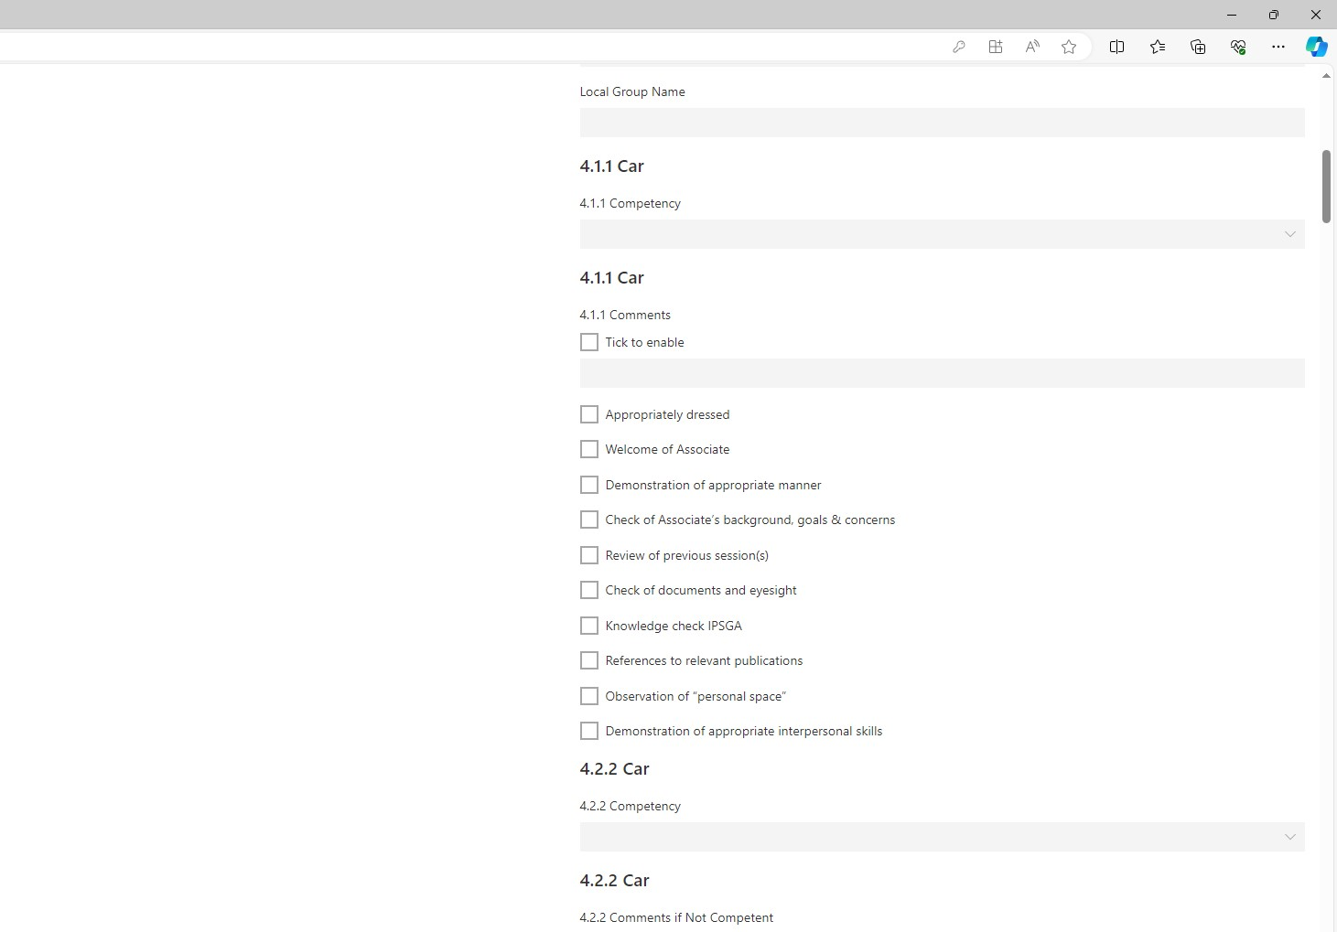
IMI National Observer Assessor Seminar 2024
Verification
Select Competent/Not Competent
Ignore these boxes
Notes:
CLICK Competent? Select ‘Competent’ for all sections. Try to avoid errors by selecting ‘Not Competent’ by mistake. This often happens by accident when using a computer mouse with a wheel
CLICK Not Competent? Select ‘Not Competent’ on the relevant competency field. There is no need to tick any other boxes in that competency, or enter any comments; they should be in the main body of the report.
Use Word to write report, then copy/paste into DARTS this will help with grammar and spelling.
Did we mention to double-check everything? Remember, the Competent/Not-competent boxes and the drive/ride scores can all be inadvertently altered by a wheel mouse.
CLICK this must contain sufficient evidence to allow the verifier to check the assessment. Does it contain the evidence for either a Fail or a Pass? Does it justify the scores for the drive/ride? Forms without sufficient evidence will unfortunately be rejected

Slide 27
IMI National Observer Assessor Seminar 2024
Results
Deferred Success
Managed development
Inform ASDM
Reassessment
Notes:
CLICK Should the candidate be unsuccessful, or decide not to take the reassessment, they must cease observing immediately as they are no longer an Observer or covered by IAMRS Group Insurance.
CLICK They can continue observing, by following the development plan from you and prepare for a National Observer re-assessment. However, this is not in place immediately, or for an indefinite period – this is for 3 months and is arranged between the group and ASDM. Any extension must be agreed by ASDM. They must be supervised by the Group Chief Observer/Training Team Lead.
The group must apply for the re-assessment and pay the £30 fee.
CLICK Please inform ASDM of any unsuccessful candidate so they can make the Group Chief Observer/Training Team Lead aware and implement a plan.
CLICK They may only have to be reassessed on unsuccessful competencies, not the full assessment.
Let’s look at that in more detail…

Slide 28
IMI National Observer Assessor Seminar 2024
Verification
Is a Drive/Ride Required?
Examples of these situations include:
Already competent
Recent Masters
Vice-Versa?
Notes:
CLICK Sometimes it is not necessary to conduct an assessed drive or ride if this element was recently assessed as competent. In this situation do not score it, simply add evidence within the comments to show when that element was passed and who assessed it.
CLICK Examples
A re-test where the reason for the previous failure was observer skills, not the ride/drive element.
CLICK A recent successful Masters Assessment
CLICK It may be that the ride/drive was not competent, but the observing element was.
Your ASDM can advise

Slide 29
IMI National Observer Assessor Seminar 2024
GDPR
©vecteezy.com
Notes:
Personal data must be stored securely - if electronically stored it must be password protected with a strong password.
Only keep personal data for as long as you have a legitimate reason for holding it.
You must securely destroy all personal data relating to individuals once you have submitted your DARTS report.
If you later need details e.g. for your tax return, then retrieve it from your DARTS record.
Remember to destroy all hard copies of notifications and test reports.
Remember to delete emails and contact numbers from your phone.

Slide 30
IMI National Observer Assessor Seminar 2024
Additional Information
Stay in touch
IMIQualifications@iam.org.uk
Inform ASDM
Notes:
CLICK Stay in touch with your ASDM – please let us know early of any problems and those candidates that you consider have potential (Masters Mentors for example)
CLICK Administration queries re IMI to IMIQualifications@iam.org.uk
CLICK Please make us aware as soon as possible of:-
A conflict of interest, or a potential complaint situation.
Please let your ASDM know when you're going on holiday or any periods of unavailability.

Slide 31
Thank you for attending. Any Questions?

