Slide 1


Masters Mentors Seminar 2024

Slide 2
Introductions
Shaun Cronin - Regional Service Delivery Team Manager (Southern)
Robbie Downing - Area Service Delivery Manager Region 4

Slide 3
What are we covering
A reminder about the Masters programme
Requirements of the Masters test
Knowledge required
Reccurring themes and misunderstandings

Slide 4
The Masters Programme
Masters is for IAMRS members only
A 90 minute on-road test with two levels of success
Unfamiliar roads of all types
The candidate will be expected to travel to the assessor – can be up to 100 miles

Slide 5
What is expected on test
A safe, legal, systematic drive or ride in accordance with Roadcraft (2020) & Motorcycle Roadcraft (2020)
Smooth, systematic, polished and flowing – think quiet efficiency
Applying cornering principles
Assessing, planning and executing safe overtaking manoeuvres
Recognising opportunities to make safe progress - a balance of progress and restraint
Cars: Are spoken thoughts required?

Slide 6
Knowledge
Masters candidates must have a sound knowledge of Roadcraft 2020 or Motorcycle Roadcraft 2020 and The Highway Code
Not knowing the “must not” rules in the HC is simply not good enough – these are legal areas for all road users
Candidates should have a theoretical knowledge of all the areas on the next slides – we know it may not be word perfect and do not expect that
Embarrassing for all concerned when the assessor asks about the key stages of planning or the three stages of overtaking and the response is an obvious fudge!

Slide 7
System
IPSGA not IPGSA or “Double system” applications
Speed of approach problems leading to rushed gear changes and decisions
Motorcyclists: front brake, rear brake or both – MC Roadcraft page 120
Quick shifters
Block changing
Auto boxes / EV / DCT – still on the brakes as they enter the hazard and / or steering
Time to react

Slide 8
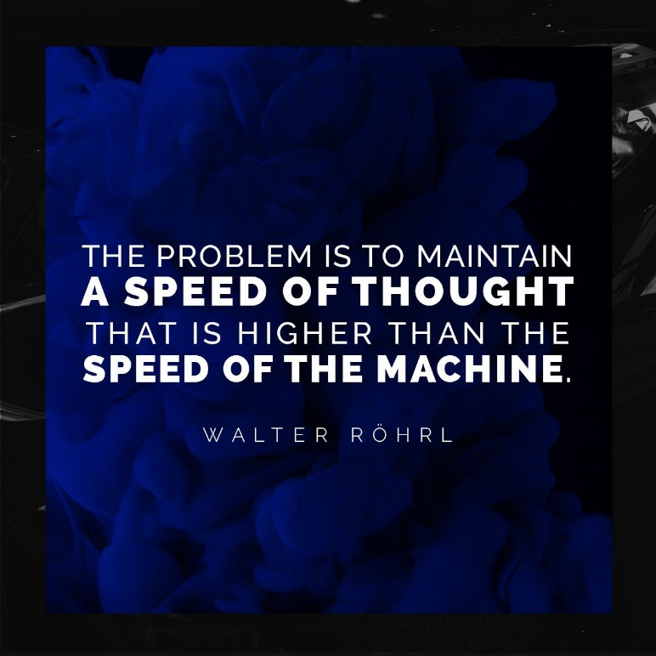
Key stages of planning
O A P D A and the 4 C’s
Observations, anticipation, planning and awareness consistent with vehicle speed
Remember – deliberation eliminates uncertainty

Slide 9
Progress & Restraint
O A P, cornering, positioning, overtaking all impact on progress (or lack of it)
When safe we should be travelling at the posted or national speed limit
Ask the question – can I stop in the distance I can see to be clear? Knowing overall stopping distances helps!
It is not an economy drive or ride – no prize for selecting a high gear too quickly
The 3 ‘UPS’
Cautious approach due to test conditions leads to excessive restraint

Slide 10
Cornering
Safety, stability, getting the best view & reducing the tightness of the bend
Technique – deceleration through the bend or a limit point analysis problem
Not matching speed to the speed at which the limit point is moving away
Cornering impacts on overtaking and progress – Five key principles for safe cornering
Always allow a margin for error when assessing the entry speed for a bend

Slide 11
Positioning
Roadcraft page 163 and MC Roadcraft page 189
Zone of relative safety
Positioning for advantage which includes junctions
Hazard prioritisation – there is no need for a candidate to position to show the assessor they have seen a hazard if the intensity of danger doesn’t require it
Following position and its impact on overtaking and progress. Roadcraft page 167 & Motorcycle Roadcraft page 194
Positioning for the brow of a hill – Roadcraft page 172 and Motorcycle Roadcraft page 200

Slide 12
Overtaking deliberation
Missed overtaking opportunities due to poor OAP
Content to follow traffic ahead – candidates must demonstrate they are researching overtakes
Going direct to a reduced following position and staying there
Remain in an extended following position and not in a position to execute an overtake
Not understanding the difference between the single stage and three stage overtaking
Use of view extensions – it's not going out to get a look
Remember - deliberation eliminates uncertainty when safe go!

Slide 13

Road Overtaking

Slide 14
Offsiding – Yes or No ?

Slide 16
Roadcraft and offsiding
At speeds within the posted limit the benefit of this extreme offside positioning is all but negated, even in Roadcraft, whose focus is on progress for emergency service drivers, the practice of offsiding is not mentioned or encouraged. It advocates positioning towards the centre line and they encourage you to consider approaching traffic, your effect on others and whether there is any advantage all very much in sync with the IAM RoadSmart advanced course material.
They finish by saying ‘Don’t position yourself in a way that causes concern to other road users.’
Roadcraft 2020 – Page 194
Motorcycle Roadcraft 2020 - Page 161
Simply – if it occurs on test and there is the slightest element of danger then the test will be stopped.

Slide 17
Using all of the tarmac - SLAP
SAFE – is it safe to do so? (Considering the view available and any hazards)
LEGAL – Is it legal to do it? (Road markings)
ACHIEVE/ADVANTAGEOUS – Does it actually achieve something? (Or are you just showboating!)
PERCEPTION – What is the perception of another road user of your actions?

Slide 18
Your questions?

Slide 19
Thank you

